Slide 1
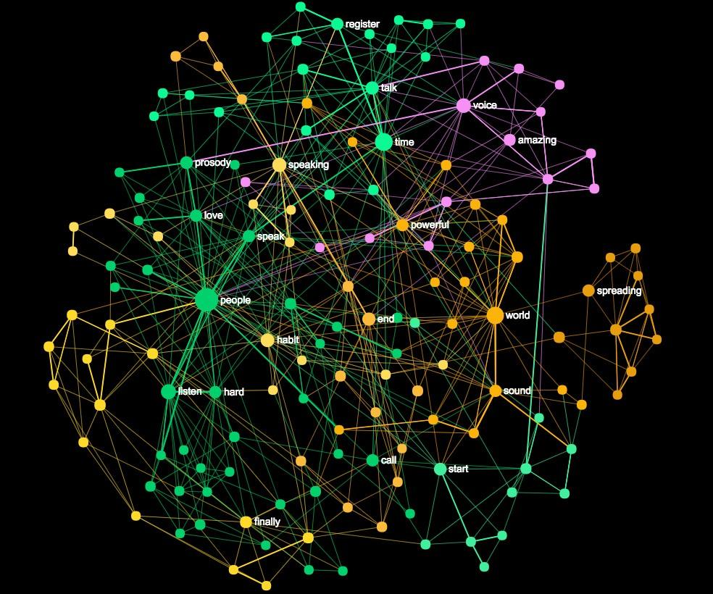
SENTIMENT ANALYSIS
OF
PRODUCT
REVIEWS

Slide 2
Presented by
Sanghamitra Biswas - 10200217034 Parna Mondal - 10200217043
Deblina Ghosh - 10200217054
Amit Roy - 10200218017
Under the guidance of
Dr. Malabika Sengupta

Slide 3
AIM OF THE PROJECT
The objective of this project is to build a supervised learning model that can automatically polarize large amounts of reviews and categorize the feedbacks of the customers over different products into Positive and Negative sets.
Our challenge is to be able to predict this information using only the raw textual data from the review.

Slide 4
INTRODUCTION
Sentiment Analysis is a part of the Natural Language Processing (NLP) techniques that consists in extracting emotions related to some raw texts.
This is usually used on social media posts and customer reviews in order to automatically understand if some users are positive or negative and why.
The goal of this study is to see how sentiment analysis of raw text reviews can be performed using python.

Slide 5
ABSTRACT
We aim to tackle the problem of sentiment polarity categorization, which is one of the fundamental problems of sentiment analysis.
Here, in this project, we have proposed a technique for classification of reviews into good or bad. We investigated if the sentiment analysis techniques are also feasible for application on product reviews.
Within the study, we first cleaned our data and then performed feature engineering to train our Random Forest Classifier on the dataset available containing around 12000 reviews.

Slide 6
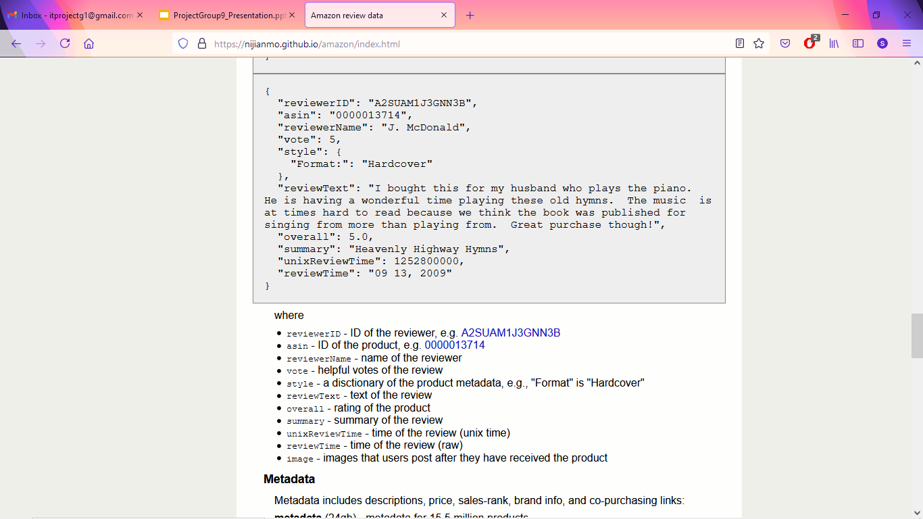
DATASET
Total number of reviews: 12169
Initial size of the data: 5 MB
Total number of reviews to Train : 9735
Total number of reviews to Test : 2434
Size of the processed data:- 30.36 GB
Example of the JSON format data from the Amazon review dataset

Slide 7
TECHNICAL REQUIREMENTS
Hardware - Processor Intel(R) Core(TM) i5-7200U CPU @ 2.50GHz 2.71 GHz, Installed RAM 4.00 GB (3.89 GB usable), System type 64-bit operating system, x64-based processor, 1TB disk space
Software - Python Notebook (Google colab), with an in-built native Python interpreter, editor and debugger
Packages used -
Pandas
Matplotlib
NLTK
Scikit-learn (Sklearn)
Seaborn

Slide 8
RAW TEXT DATA
PREPROCESSING
COUNTING WORDS AND CHARACTERS
ADDING TF-IDF SCORES
Feature Extraction from the Preprocessed Text
GENERATING SENTIMENT SCORES
Data to train our model
SPLITTING THE DATASET
Data to assess our model
TRAIN RANDOM FOREST CLASSIFIER
TEST DATA
PREDICTION MODEL
VALIDATING THE MODEL
MODEL REPORT GENERATION
WORKFLOW DIAGRAM

Slide 9
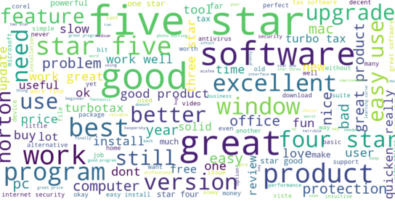
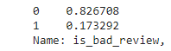
SOURCE DATA
We have only text reviews with their ratings (1 to 5) as our source data.
To simplify the problem, we will split it into two categories:
0 (as positive reviews) - for ratings 3 and above
1 (as negative reviews) - for ratings 2 and below

Slide 10
PRE-PROCESSING
Steps Used to Clean our Data:
Transforming Text into Lowercase
Tokenization of the text and Removing Punctuation
Removing Stopwords
Removing single letters and numbers
Performing Lemmatization
Step 1

Slide 11
COUNTING WORDS AND CHARACTERS
Counting the total number of words in every review (nb_words)
Counting the total number of characters in every review (nb_chars)
Adding the columns into our dataset to use as features
Step 2

Slide 12
TF-IDF SCORE
CALCULATION
Selecting words that appear in at least 10 different reviews
Adding TF-IDF columns for all the selected words
Using the TF-IDF score as features to train our model
Step 3

Slide 13
TF (Term Frequency)
IDF (Inverse Document Frequency)
Count of the word in the document
÷
Number of words in the document
Count of documents in the corpus
÷
Number of documents containing the word
tf-idf(w,d) = tf(w,d) * log( idf(w) )
, where w = word (term)
d = document (review text)

Slide 14
PERFORMING SENTIMENT ANALYSIS
Adding sentiment analysis features using Vader from NLTK module
Generating sentiment scores for each review
Integrating the scores as features in our model
Step 4

Slide 15
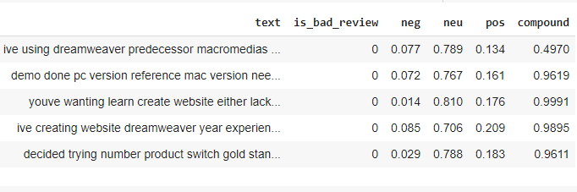
We have used the polarity_scores() method from Vader to perform sentiment analysis of our review text.
For each review, Vader returns 4 values:
a neutral score
a positive score
a negative score
a compound score, that summarizes the previous scores

Slide 16
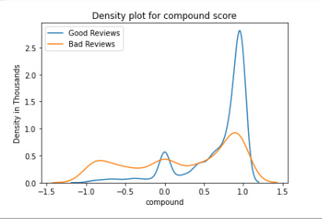
DENSITY PLOT

Slide 17
SPLITTING THE DATASET
Using the test_train_split function to randomly split our data into 8:2 ratio
80% of the data to train our model
20% of the data to assess our model
Generating four portions of data - x_train, y_train, x_test, and y_test
x_train - training features
y_train - training label
x_test - testing features
y_test - testing label
Step 5

Slide 18
TRAINING OUR CLASSIFICATION MODEL
Choosing the four sentiment scores and the weighted words as features for training our model
X axis - A vector with a length of 5966 features
Y axis - A rating of 0 (good review) or 1 (bad review) as label
Using Random Forest (RF) Classifier from Scikit-Learn library for the predictions on the test data
Step 6

Slide 19
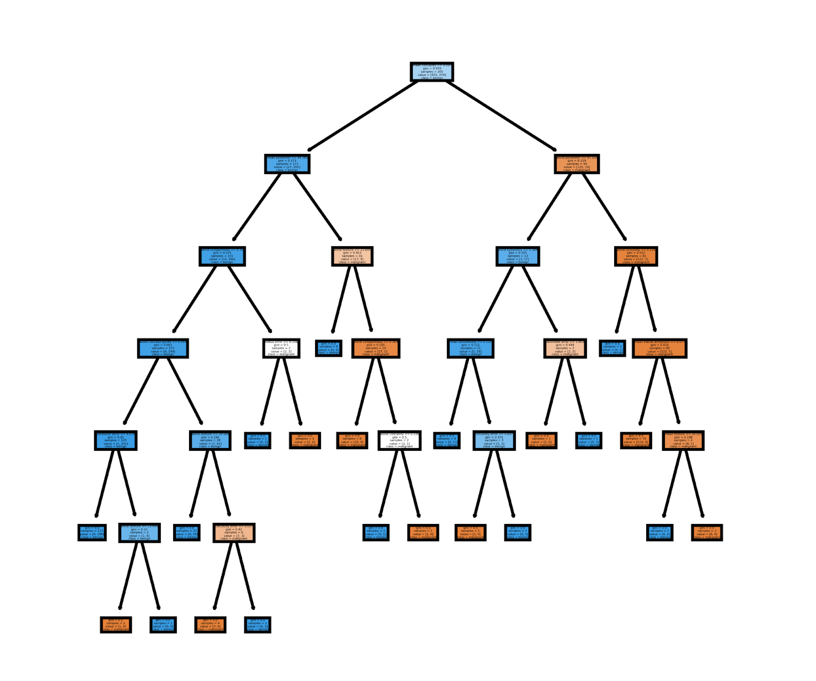
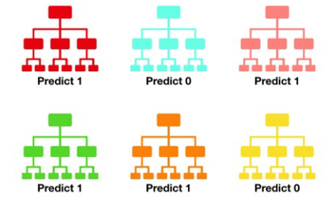
Random Forest Classifier
Random forest consists of a large number of individual decision trees that operate as an ensemble.
Each individual tree in the random forest spits out a class prediction and the class with the most votes becomes our model’s prediction.
One decision tree of the Random Forest
Visualization of Random Forest making a prediction

Slide 20
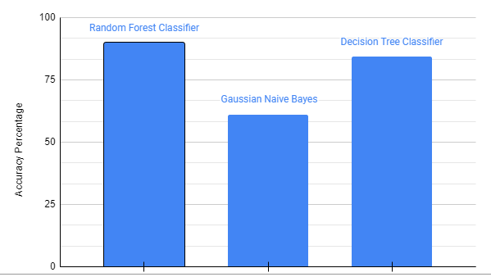
The accuracy shown by our model is - 90%

Slide 21
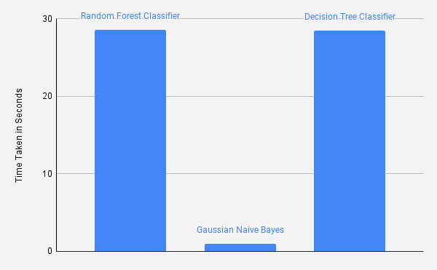
The time taken by the Random Forest Classifier is - 28s

Slide 22
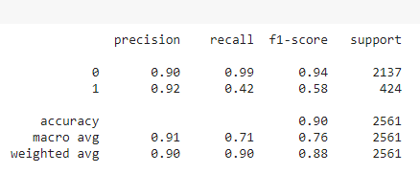
CLASSIFICATION REPORT

Slide 23
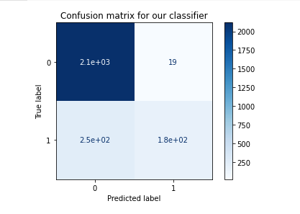
True Positives(TP) → True label - 0 and Predicted label - 0
True Negatives(TN) → True label - 1 and Predicted label - 1
False Positives(FP) → True label - 1 and Predicted label - 0
False Negatives(FN) → True label - 0 and Predicted label - 1

Slide 24
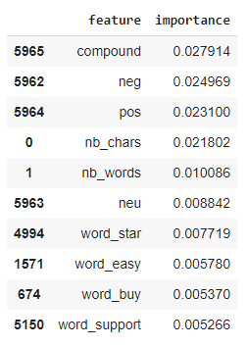
FEATURE IMPORTANCE
This represents the top ten input features out of 5966 total features and their relative importance in the final decision tree.
The most important features are indeed the ones that come from the previous sentiment analysis. The word count (nb_words) and the character count (nb_chars) also appear to have a fairly good contribution to the final prediction.

Slide 25
CONCLUSION
Our current model based on Random Forest Classifier can provide an accuracy of 90% in classifying the raw text reviews into POSITIVE or NEGATIVE.
It is to be noted that for the ease of validation, we have manually separated the positive and negative reviews through their rating, and thus a portion of the inaccuracy can be blamed on this.
It is completely possible to use only raw text data as input for making predictions.
The most important thing is to be able to extract the relevant features from this raw source of data.

Slide 26
FUTURE SCOPE
The model can be improved further by extracting more features from our raw text data and incorporating them to train our classifier.
Based on all the reviews for a particular product we can generate a score to help the customers understand better about the reviews in general.
Using a large-scale dataset, that has enough positive and negative reviews, for the model can help improve the predictions.
We will try to generalize this model to understand the sentiment of all kinds of texts, from simple reviews to user comments.

Slide 27
REFERENCES
1. T. K. Shivaprasad and J. Shetty, "Sentiment analysis of product reviews: A review," 2017 International Conference on Inventive Communication and Computational Technologies (ICICCT), Coimbatore, India, 2017, pp. 298-301.doi: 10.1109/ICICCT.2017.7975207
2. Fang, X., Zhan, J. Sentiment analysis using product review data. Journal of Big Data 2, 5 (2015). https://doi.org/10.1186/s40537-015-0015-2
3. M. Goodarzi, M. T. Mahmoudi and R. Zamani, "A framework for sentiment analysis on schema-based research content via lexica analysis," 7'th International Symposium on Telecommunications (IST'2014), 2014, pp. 405-411, doi: 10.1109/ISTEL.2014.7000738.
4. Prerana Singhal, Pushpak Bhattacharya. Sentiment Analysis and Deep Learning: A survey. Dept. of Computer Science and Engineering , Indian Institute of Technology, Powai Mumbai, India.
5. Mohey El-Din, Doaa. (2016). Analyzing Scientific Papers Based on Sentiment Analysis (First Draft). 10.13140/RG.2.1.2222.6328.

